Slide 1
Divulgazione sui Social Media e Brevettazione
LA TEORIA E LA PRATICA

Slide 2
World Intellectual Property Organization (WIPO)
STANDING COMMITTEE ON THE LAW OF PATENTS
Fourth Session
Geneva, November 6 to 10, 2000
DISCLOSURE OF TECHNICAL INFORMATION ON THE INTERNET
AND ITS IMPACT ON PATENTABILITY
Existing Legislation and Practices
Japan
B. United States of America
C. European Patent Convention (EPC)

Slide 3
Notice from the European Patent
Office concerning internet citations
Practice followed at the EPO when citing documents retrieved from the internet in both the European and the PCT procedure
Notice from the European Patent Office concerning internet citations OJ EPO 2009, 456
Online publication date: 2.8.2016 - Official Journal EPO – Pages 2012-218
In addition: Guidelines for Examination 2016 - Part G - IV, 7.5.

Slide 4
Notice from the EPO concerning
INTERNET CITATIONS
Internet disclosures
  As a matter of principle, disclosures on the internet form part of the state of the art according to Art. 54(2) EPC and Art. 33(2) PCT.
  Information disclosed on the internet or in online databases is considered to be publicly available as of the date the information was publicly posted.
  For the sake of a valid patent it is hence often crucial to cite publications only obtainable from such internet websites.

Slide 5
Notice from the EPO concerning
INTERNET CITATIONS
Establishing the publication date.
Standard of proof.
Burden of proof.
Disclosures which have no date or an unreliable date: Evidence may come from an internet archiving service, the most prominent being the internet archive accessible through the so called "Wayback Machine" (www.archive.org).
Internet disclosures submitted by a party to opposition proceedings are assessed according to the same principles as are applied in examination proceedings.

Slide 6
USPTO – AIA
(America Invents Act 35 U.S.C. 102)
A person shall be entitled to a patent unless—
(1) the claimed invention was patented, described in a printed publication, or in public use, on sale, or otherwise available to the public before the effective filing date of the claimed invention; or
NB: applications filed on or after March 16, 2013.

Slide 7
USPTO – pre-AIA
(35 U.S.C. 102)
A person shall be entitled to a patent unless —
(a) the invention was known or used by others in this country, or patented or described in a printed publication in this or a foreign country, before the invention thereof by the applicant for patent, or

Slide 8
USPTO Manual of Patent Examining Procedure (MPEP 2128 + ...)
A REFERENCE IS A “PRINTED PUBLICATION” IF IT IS ACCESSIBLE TO THE PUBLIC
to the extent that persons interested and ordinarily skilled in the subject matter or art, exercising reasonable diligence, can locate it.
For Internet search engines, such as Google®, Yahoo®, and Bing®,
print out the first page and any of the following pages that include
names of any Web pages reviewed during the search.
Prior art disclosures on the Internet or on an online database are considered
to be publicly available as of the date the item was publicly posted.
An electronic publication, like any publication, may be relied upon for all that
it would have reasonably suggested to one having ordinary skill in the art.

Slide 9
ESEMPI USA
Patent Trial and Appeal Board (PTAB)
Post-Grant Review 35 U.S.C. § 324(a) - PGR2018-00020 - Instituted
BREVETTO US 9,811,184 B2 TITOLARE: DODOCASE VR, INC.
PRIORITA’ 14-05-2015 (16-07-2014)
VISORE DI REALTA’ VIRTUALE E MECCANISMO DI GESTIONE COMANDI

Slide 10
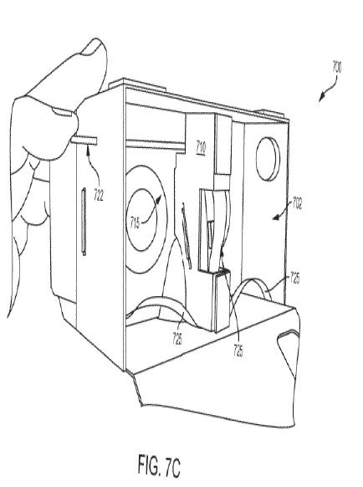
VARIANTE BREVETTO US 9,811,184 B2

Slide 11
Arte nota: pagina web datata, 28-6-2014, e commento datato 7-7-2014
GOOGLE CARDBOARD
https://gigaom.com/2014/06/28/why-google-cardboard-is-actually-a-huge-boost-for-virtual-reality/

Slide 12
PTAB
REQUEST OF INTER PARTES REVIEW 22-12-2017
UNDER 35 U.S.C. §§ 311-319 - IPR2018-00396 - Denied Institution
BREVETTO US 8,785,758 B2 TITOLARE INMUSIC BRANDS, INC.
PRIORITA’ 01-09-2010 (15-10-2010)
CONTROLLER ELETTRONICO DI PIATTI PER FARE MUSICA (PIATTI HIGH-HAT)

Slide 13
ARTE NOTA YOUTUBE - PARTE MECCANICA
https://www.youtube.com/watch?v=sZQBkX4SIJs
16-02-2009 Wayne VanDerBroeke

Slide 14
ARTE NOTA YOUTUBE - PARTE ELETTRONICA
https://www.youtube.com/watch?v=8UJcKxX7W50
21-02-2009 Wayne VanDerBroeke

Slide 15
US CORTE APPELLO FEDERALE 27-07-2018
2017-1894 e 2017-1936 - VACATED AND REMANDED
GOPRO, INC. V. CONTOUR IP HOLDING LLC
BREVETTI: US 8,890,954 B2 E US 8,896,694 B2 TITOLARE: CONTOUR LLC
PRIORITA’ 13-09-2010 (13-09-2009)
VIDEOCAMERA PORTATILE CONFIGURATA PER ACQUISIRE E VISUALIZZARE IMMAGINI DA REMOTO

Slide 16
ARTE NOTA: CATALOGO GOPRO 2009 E YOUTUBE
CATALOGO PRESENTATO IN FIERA
Tucker Rocky Dealer Show 2009
Fort Worth, Texas, from July 23 through July 27, 2009
https://www.google.it/search?q=GoPro+Catalog+2009&tbm=isch&tbo=u&source=univ&sa=X&ved=2ahUKEwjOp-v89PbdAhUitYsKHUPCAsgQsAR6BAgGEAE&biw=1360&bih=626
TELECAMERA CONFIGURATA PER ACQUISIRE E TRASMETTERE
IMMAGINI DA REMOTO (WIRELESS)

Slide 17
PTAB
APPELLO CONTRO RIFIUTO BREVETTO
3-10-2017
DOMANDA US PUBBLICATA CON N. US 2009/0156334 A1 TITOLARE: ABC Inc.
PRIORITA’ 17-12-2007
APPARATO E METODO DI ROTAZIONE DI UNA PORTA PER SPORT DI CALCIO
CLAIL 23. A method of using a sports field system, .... .

Slide 18

ARTE NOTA YOUTUBE
Video dal titolo
‘Royal High School Soccer 2004,’
https://www.youtube.com/watch?v=0PZzd6QGSic
MIN 2:46/12:33

Slide 19
OPPOSIZIONE AVANTI ALL’EPO
BREVETTO EUROPEO EP 2 760 277 B1 TITOLARE: ROCKWOOL INTERNATIONAL A/S
PRIORITA’ 22-12-2011 - EMENDATO
SISTEMA PER LA CRESCITA DI PIANTE

Slide 20
ARTE NOTA: RICERCA SU GOOGLE ‘UNI-SLAB’
ESEMPIO DI AUTO-ANTICIPAZIONE
DATA DI PUBBLICAZIONE: 13-12-2011 INDICATA SU ‘web.archive.com’
DOCUMENTO 5a: Il documento descrive tutte le caratteristiche della rivendicazione 1
http://www.grodan101.com/growing-tips/grow/what-know-about-uni-slab
http://www.grodan101.com/about-us/grodan-associated-companies

Slide 21
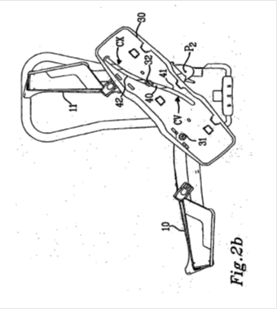
OPPOSIZIONE AVANTI ALL’EPO
BREVETTO EUROPEO EP 2 664 497 B1 TITOLARE THULE SWEDEN AB
DEPOSITO 18-05-2012 EMENDATO
SUPPORTO DI CARICO PER VEICOLO

Slide 22
Arte Nota: YouTube
V1 del 2 aprile 2010
V3 del 6 luglio 2011
https://www.youtube.com/watch?v=yKZ7kXC-hpc
V2 del 29 agosto 2011 m 0.58/2.54
Strawman Limited (Movanext M2 By Van Seggeren ?)

Slide 23
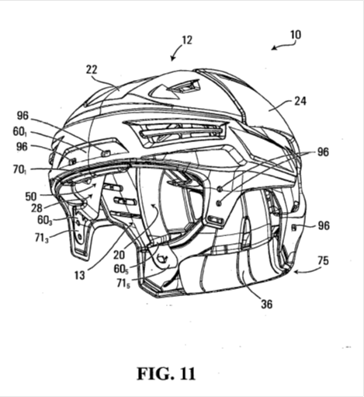
OPPOSIZIONE AVANTI ALL'EPO -
DECISONE DI REVOCA DATATA 11-09-2018
REVOCATO PER AUTOANTICIPAZIONE
BREVETTO EUROPEO EP 2 550 886 B1 TITOLARE BAUER HOCKEY CORP.
DEPOSITO: 27-07-2012
PRIORITA' 1: 27-07-2011
PRIORITA' 2: 16-01-2012
CASCO PER SPORT CON PROTEZIONE DA ROTAZIONE

Slide 24
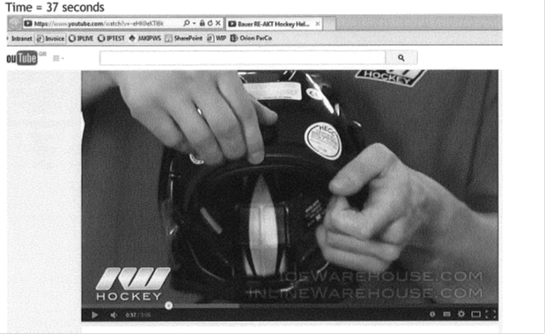
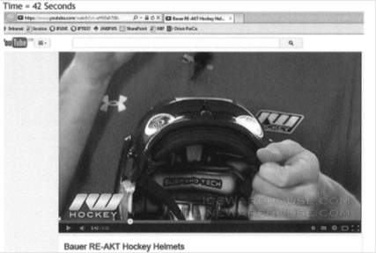
ARTE NOTA: YOUTUBE
https://www.youtube.com/watch?v=-eHK0eKTl8k
D6f del 27 aprile 2012 m 0.25-1.20/3.05
Rivendicazione della PRIORITA' dubbia sulla base dell'Art. 87(1) EPC

Slide 25
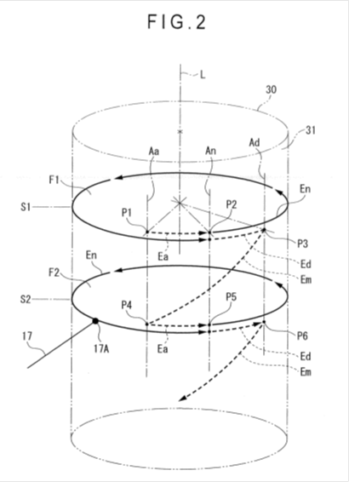
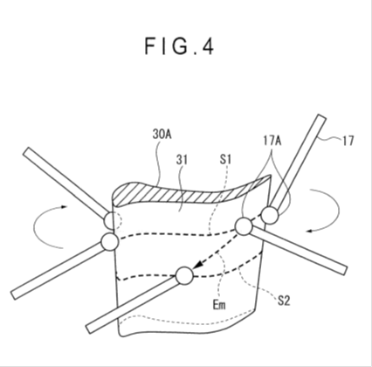
OPPOSIZIONE AVANTI ALL'EPO - DECISIONE DEL 8-12-2016
BREVETTO EUROPEO EP2527782 - TITOLARE MITUTOYO CORP.
APPELLO IN CORSO
PRIORITA' 27-05-2011 MANTENUTO DOPO OPPOSIZIONE
METODO PER LA MISURAZIONE DELLA SEZIONE DI PROFILI

Slide 26
ARTE NOTA: YOUTUBE
https://www.youtube.com/watch?v=XqtVzAqWHFw
D1 del 29 giugno 2009 m 4:59/6:49

Slide 27
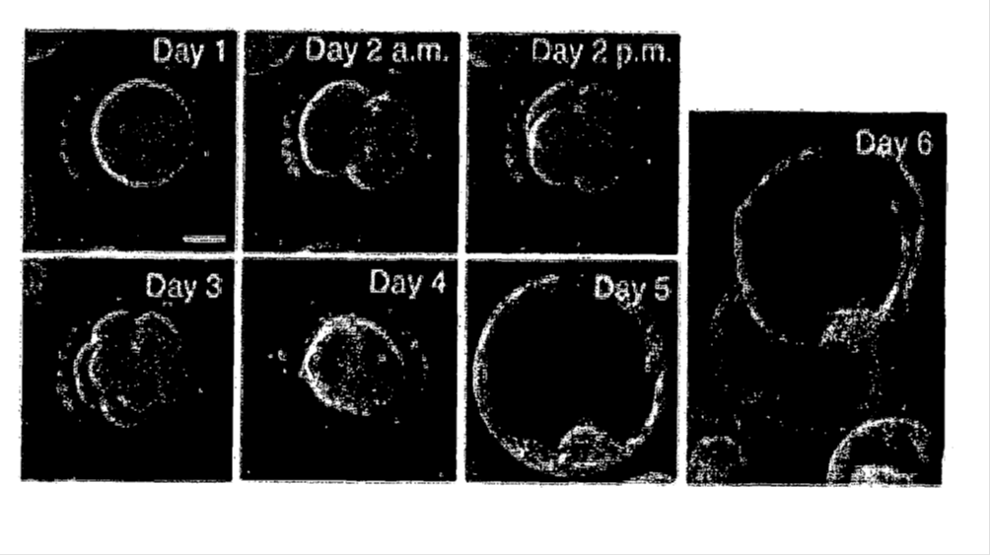
OPPOSIZIONE AVANTI ALL'EPO - DECISIONE DEL 26-02-2016
BREVETTO EUROPEO EP 2 430 454_B1
TITOLARE BOARD OF TRUSTEES - LELAND STANFORD JUNIOR UNIV.
APPELLO IN CORSO
PRIORITA' 22-08-2009 e 07-05-2010
RAPPRESENTAZIONE DI EVOLUZIONE DI EMBRIONI, DI OVOCITI E DI CELLULE STEMINALI

Slide 28
ARTE NOTA: YOUTUBE
https://www.youtube.com/watch?v=6lnr4HWiz9M
D10 del 14 aprile 2010 - Prague Fertility Centre

Slide 29
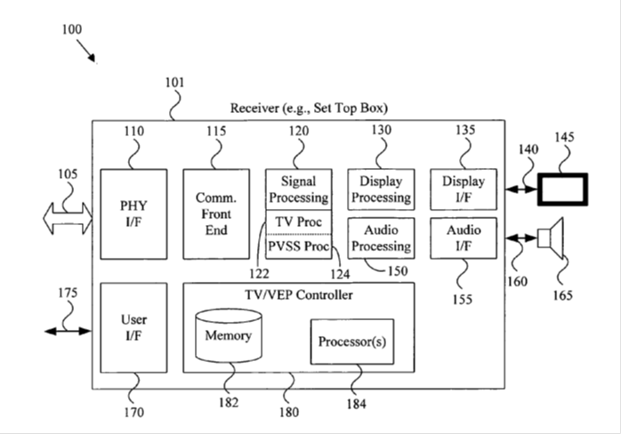
DOMANDA DI BREVETTO DECISIONE DI RIFIUTO DEL 27-03-2012
EP2161917 - TITOLARE BROADCOM CORP.
PRIORITA': 08-09-2008 e 19-11-2008 DOMANDA RIFIUTATA
SISTEMA E METODO TV PER PRESENTARE VIDEO BASATI SU UNA RETE DI COMPUTER

Slide 30
ARTE NOTA: APPLE
ARTE NOTA: SONY
CUPERTINO, Calif., June 20 /PRNewswire-FirstCall/ —
Apple(R) today announced that iPhone(TM) users will be able to enjoy YouTube's originally-created content on their iPhones when they begin shipping on June 29 [2007]. A new Apple-designed application on iPhone will wirelessly stream YouTube's content to iPhone over Wi-Fi or EDGE networks and play it on iPhone's stunning 3.5 inch display.
https://www.apple.com/newsroom/2007/06/20YouTube-Live-on-Apple-TV-Today-Coming-to-iPhone-on-June-29/
D3 del 20 giugno 2007
"YOUTUBE CONTENT NOW AVAILABLE ON SONY BRAVIA INTERNET VIDEO LINK"
https://www.youtube.com/watch?v=3rJwVK4Auts
D2 del 15 gen 2008 - Caricato da avingusa
Sony bolsters BRAVIA internet video link content with CBS.

Slide 31
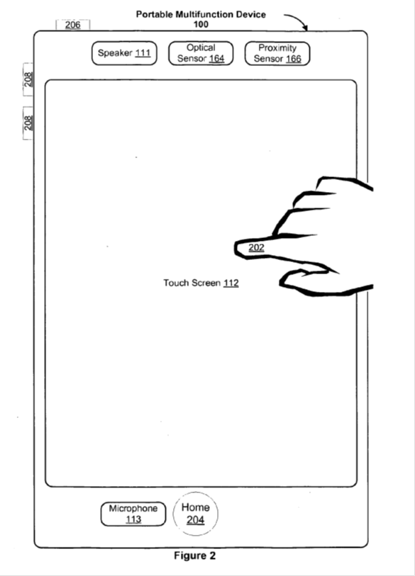
OPPOSIZIONE AVANTI AL TRIBUNALE TEDESCO - DECISIONE DEL 21-10-2015
BREVETTO TEDESCO 602007009551 REVOCATO
BREVETTO EUROPEO EP2059868 (DE 602007009551) - TITOLARE APPLE INC.
PRIORITA': 06-09-2006, 06-01-2007, 07-01-2007, 08-01-2007, 29-06-2007, 30-08-2007
DISPOSITIVO PORTATILE PER GESTIRE FOTO

Slide 32
.........

Slide 33
ARTE NOTA: PRESENTAZIONE ALLA "APPLE CONVENTION 2007"
AUTO-ANTICIPAZIONE
https://www.youtube.com/watch?v=s72uTrA5EDY
Registrazione Video del 9 gennaio 2007
MACWORLD 2007 SAN FRANCISCO (33:00-33:40 + 42:30-42:48)/51:18

Slide 34
CONCLUSIONI
IN CASO DI NUOVA PRESUNTA INVENZIONE
SEMBREREBBE CHE LA RICERCA
SU DOCUMENTI BREVETTUALI E/O
SU RIVISTE SCIENTIFICHE
NON SIA SUFFICIENTE

Slide 35
CONCLUSIONI
IN PASSATO ERANO TIPICI I CASI DI
AUTO-ANTICIPAZIONE
IN PARTICOLARE SU RIVISTE SCIENTIFICHE
ATTUALMENTE SONO MOLTO FREQUENTI I CASI DI
ANTICIPAZIONE DA PARTE DI ALTRI
IN PARTICOLARE SUI SOCIAL MEDIA

Slide 36
CONCLUSIONI
SEMBRA CHE I CASI DI ANTICIPAZIONE SUL WEB
SIANO TECNOLOGICAMENTE TRASVERSALI
IN ALTRE PAROLE SEMBRA NON RIGUARDINO
IL SOLO SETTORE INFORMATICO
MA RIGUARDINO MOLTEPLICI SETTORI TECNOLOGICI

